Slide 1
Predikcija bolesti srca
Vasiljevic Velibor
Mentor: Igor Jovin

Slide 2
Motivacija
U americi na svakih 37 sekundi 1 osoba umre od srcanih bolesti
Svake godine 647 000, na svake 4 smrti jedna je od srcanih bolesti
Svakih 40 sekundi neko ima srcani udar
1 u 5 srcanih udara su “tihi”, steta je naneta ali mi to ne osetimo
Najcesci razlozi: dijabetes, gojaznost, nezdrava ishrana, fizicka neaktivnost, preterana upotreba alkohola

Slide 3
Dataset 1 - Cleveland
age
sex (1 = male; 0 = female)
cp: chest pain type (1: typical angina, 2: atypical angina, 3: non-anginal pain, 4: asymptomatic)
trestbps: resting blood pressure (in mm Hg on admission to the hospital)
mochol: serum cholestoral in mg/dl
years (number of years as a smoker)
fbs: (fasting blood sugar > 120 mg/dl) (1 = true; 0 = false)
restecg: resting electrocardiographic results (0: normal, 1: having ST-T wave abnormality, 2: showing probable or definite left
ventricular hypertrophy by Estes' criteria
thalach: maximum heart rate achieved
exang: exercise induced angina (1: yes, 0: no)
oldpeak = ST depression induced by exercise relative to rest
slope: the slope of the peak exercise ST segment (1: upsloping, 2: flat, 3: downsloping ldv5: height at rest)
ca: number of major vessels (0-3) colored by flourosopy
thal: 3: normal, 6, fixed defect, 7 reversable defect
num: diagnosis of heart disease (0: < 50% diameter narrowing, 1: > 50% diameter narrowing)

Slide 4
Dataset 2 - Framingham
age
male(0 – zensko, 1 - musko)
education
currentSmoker (0 – nepusac, 1 - pusac),
cigsPerDay, BPMeds (lekovi za visok pritisak, 0 – ne uzima, 1 - uzima),
prevalentStroke (da li je osoba do sad imala srcani udar 0/1),
prevalentHyp (da li je osoba do sad imala visoki krvni pritisak 0/1),
diabetes (0 – nema, 1 - ima), totChol (nivo holesterola u krvi mg/dL),
sysBP(systolic? mmHg),
diaBP(diastolic? mmHg),
BMI (“Body Mass Index” = tezina/visina),
heartRate (beats/min)
glucose (mg/dL)
TenYearCHD (target)

Slide 5
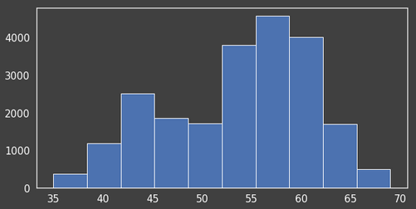
Broj ljudi/godine

Slide 6
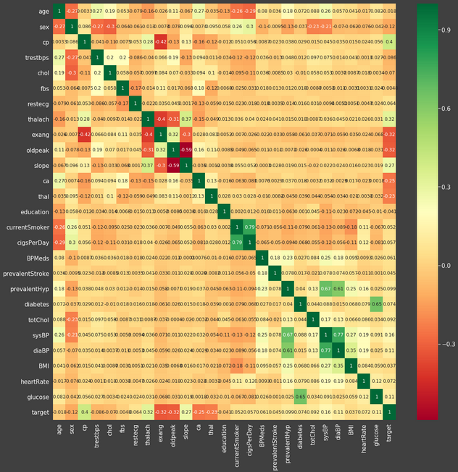
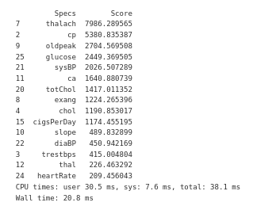

Slide 7
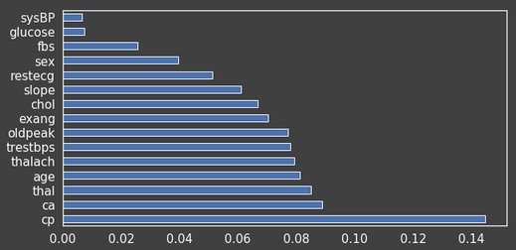

Slide 8
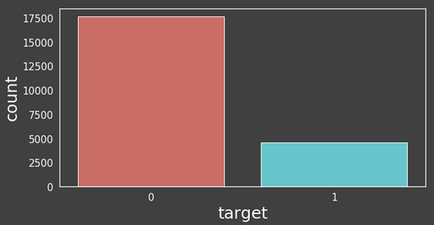

Slide 9
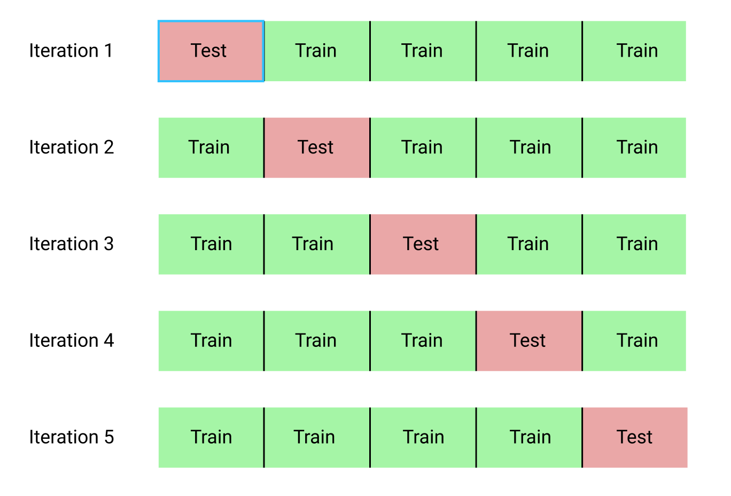
K folds cross validation split

Slide 10
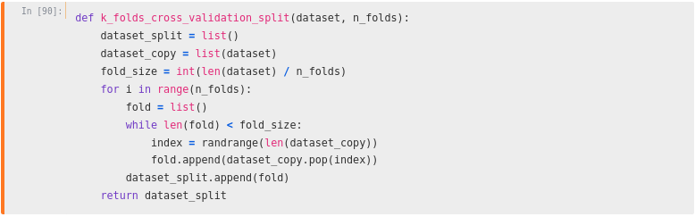
Implementation

Slide 11
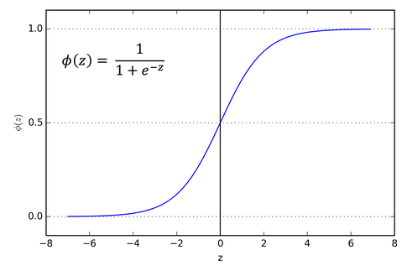
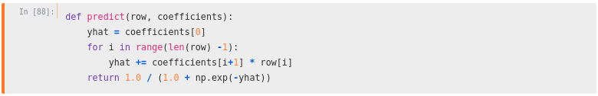
Sigmoid

Slide 12

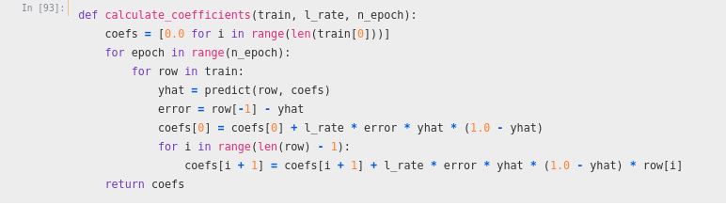
Koeficijenti

Slide 13
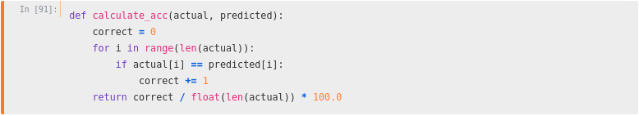
Racunanje tacnosti

Slide 14
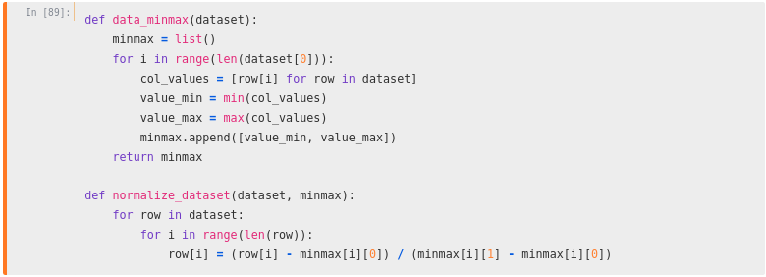
Normalizovanje podataka

Slide 15
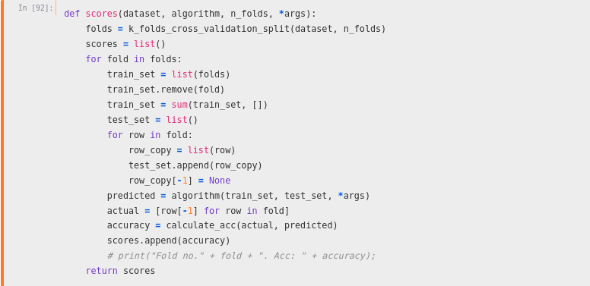
Rezultati

Slide 16
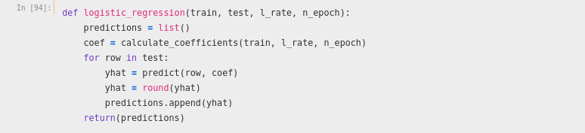
Logisticka regresija

Slide 17
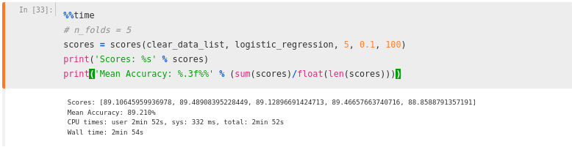
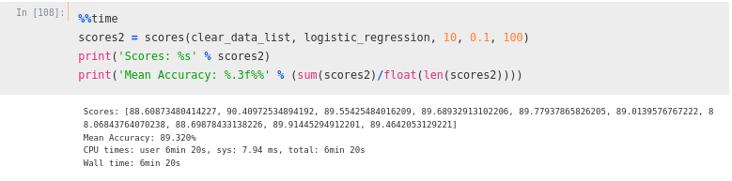
Konacni rezultati
FALIIIIIIIIIIII

Slide 18
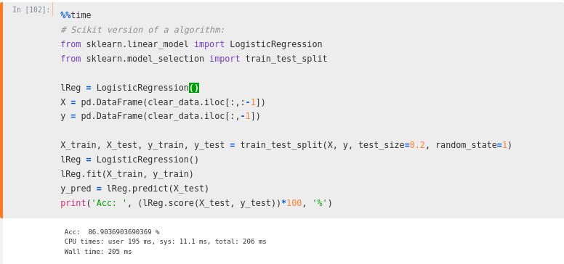
Poredjenje sa skleanovom gotovom f-jom

Slide 19
Hvala na paznji!

Slide 20
Reference
https://intellipaat.com/blog/what-is-logistic-regression/
https://www.geeksforgeeks.org/ml-stochastic-gradient-descent-sgd/
https://machinelearningmastery.com/gradient-descent-for-machine-learning/
https://machinelearningmastery.com/k-fold-cross-validation/
https://www.geeksforgeeks.org/cross-validation-machine-learning/
https://en.wikipedia.org/wiki/Sigmoid_function
https://www.coursera.org/learn/machine-learning
http://aima.cs.berkeley.edu/
https://machinelearningmastery.com/logistic-regression-for-machine-learning/
https://machinelearningmastery.com/logistic-regression

Slide 21
Datasets
https://www.kaggle.com/ronitf/heart-disease-uci
https://www.kaggle.com/amanajmera1/framingham-heart-study-dataset

